Slide 1

Exploratory Data Analysis
Week11 – EDA Bank Marketing Campaign
26-Feb-2024

Slide 2
Agenda
Executive Summary
Problem Statement
Approach
EDA
EDA Summary
Recommendations

Slide 3
Executive Summary
Overview of the project's goal: Analyzing a Portuguese bank's marketing data to predict customer subscription likelihood to a term deposit.
Key findings: Outlier treatment enhances data quality and model accuracy.

Slide 4
Problem Statement
The project aims to predict customer subscription likelihood to a term deposit, requiring accurate data analysis and outlier management for effective marketing resource allocation.

Slide 5
Approach
Methodology: Data cleaning (handling missing values and outliers using Z-score and IQR methods) and exploratory data analysis (EDA) techniques.

Slide 6
EDA
Execution of descriptive statistics, visualization (histograms, box plots, scatter plots, correlation matrices), and analysis of variable relationships.

Slide 7
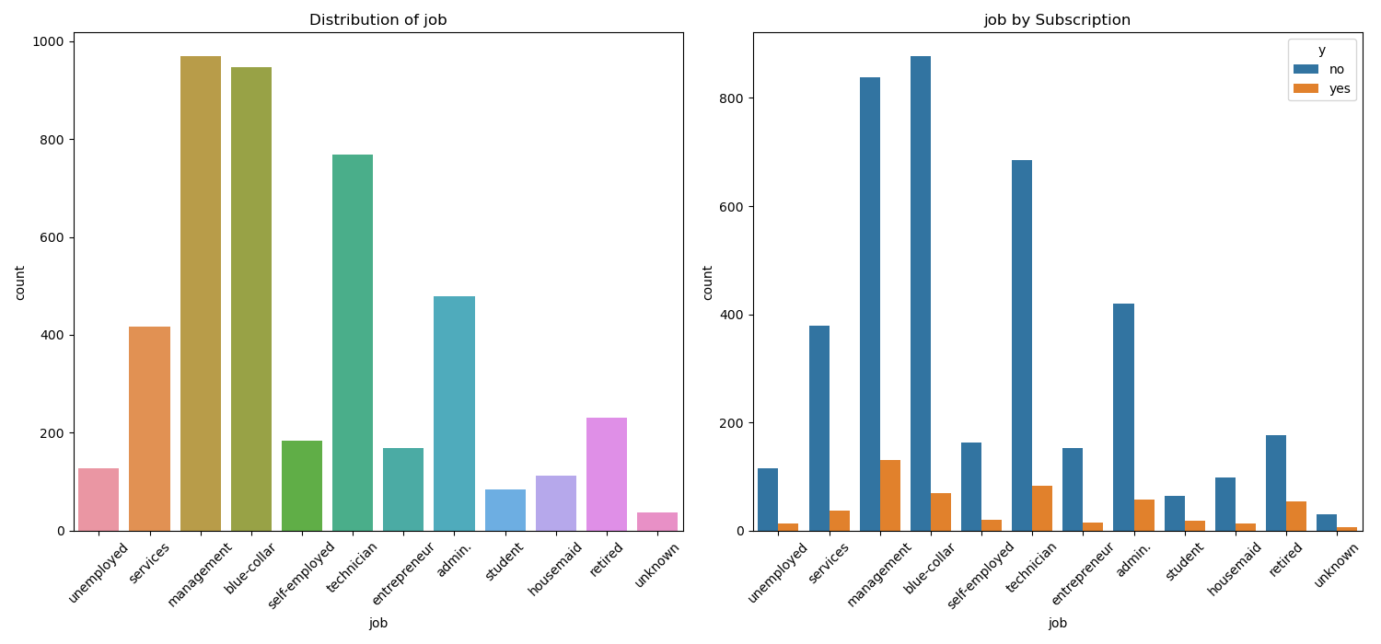
EDA Summary
Observation: Management, Blue-collar, Technician (3 positions) were the majority (58%) by following admin and service position. However, even tough there almost same number of people in management and blue-collar section, more people in management occupation has reported Y(yes) to the subscription by almost double. Which means there are more chances of selling our product to management, than clue-collar despite the total number is almost the same. Additionally In terms of proportion,

Slide 8
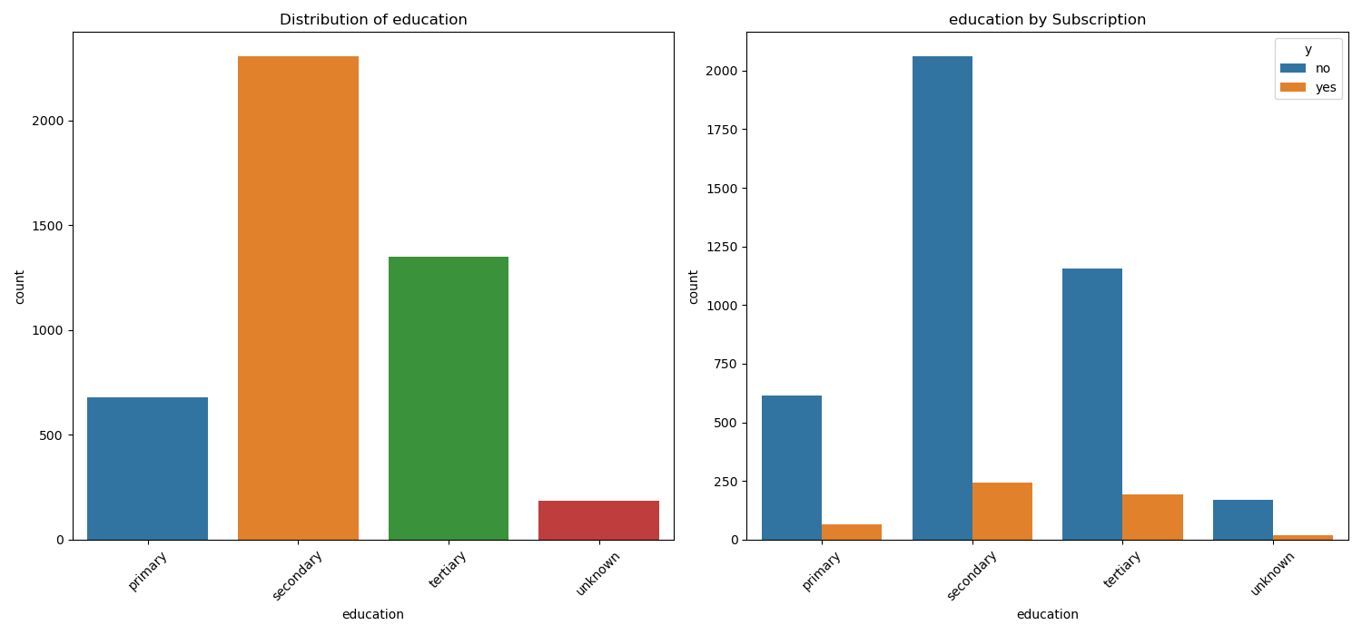
EDA Summary
Observation: People who completed tertiary education has reported Y the most(proportionally), and secondary(in numbers). Even tough there’s a difference in numbers (Between Secondary and Tertiary)by double, tertiary education has reported almost same numbers of Y s. In conclusion, our main consumers are most likely to be Tertiary( and Secondary)

Slide 9
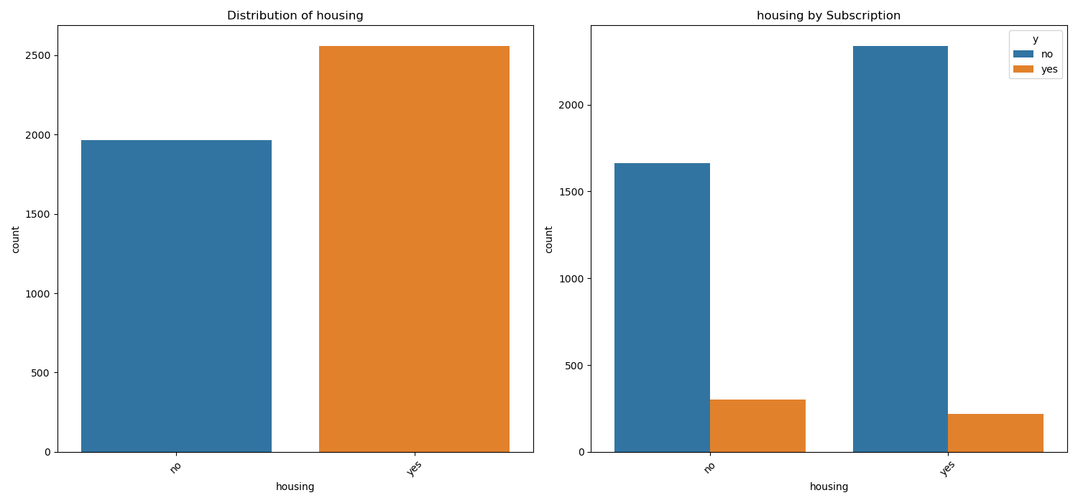
EDA Summary
Observation: 56% of total replied they have housing loan, and the others replied they don’t. However more people who do not have housing loan subscribed(proportionally). In conclusion, People who do not have housing loan are more likely to subscribe than those people who do. But due to the little numeric relationship, housing factor should not be considered rigorously as others. (Related but not as much as others are)

Slide 10
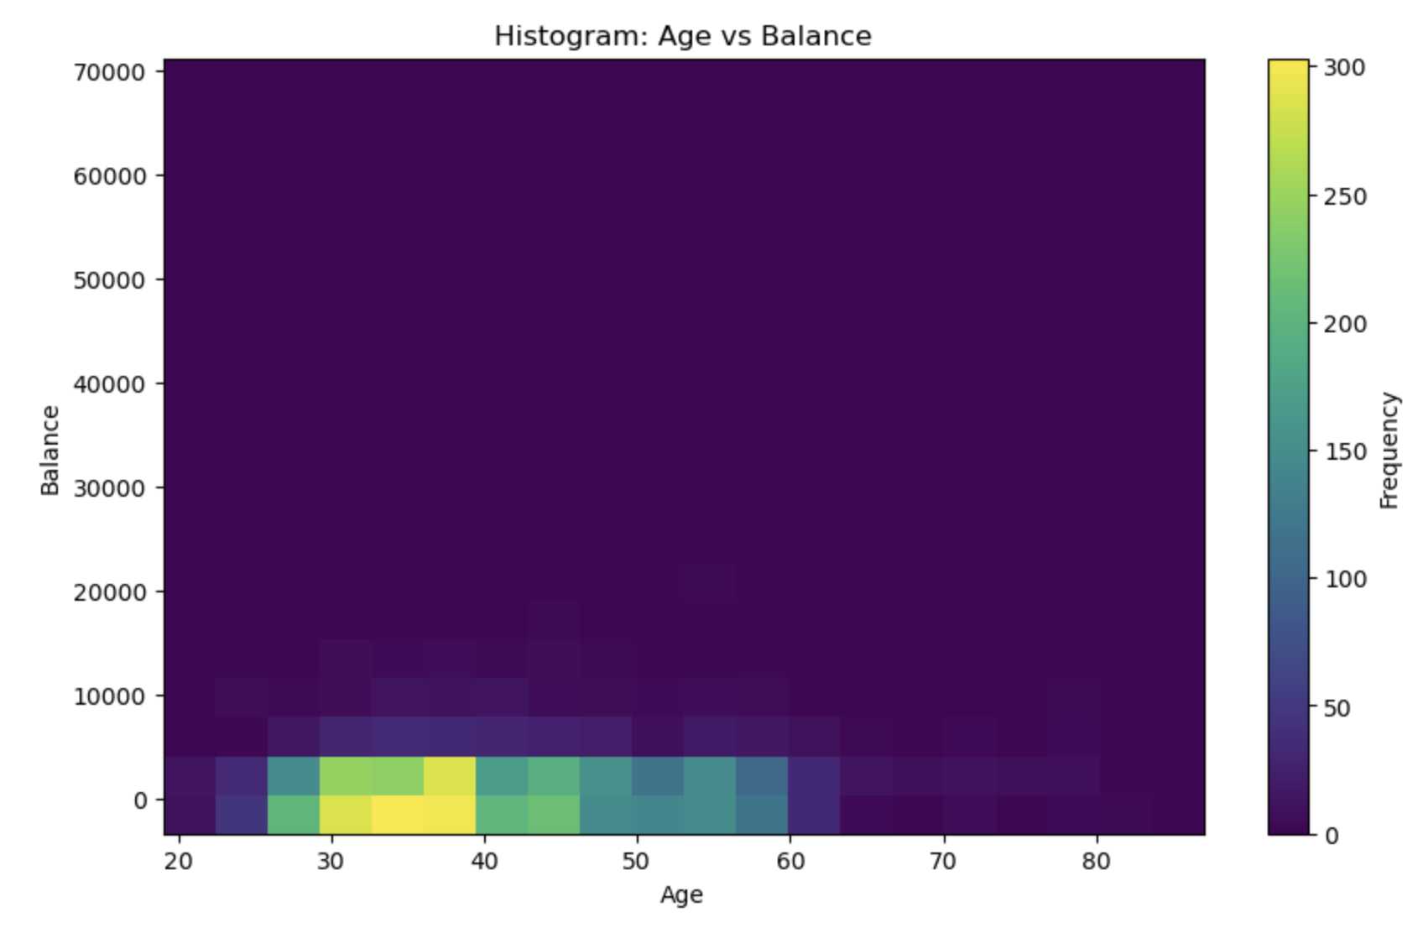
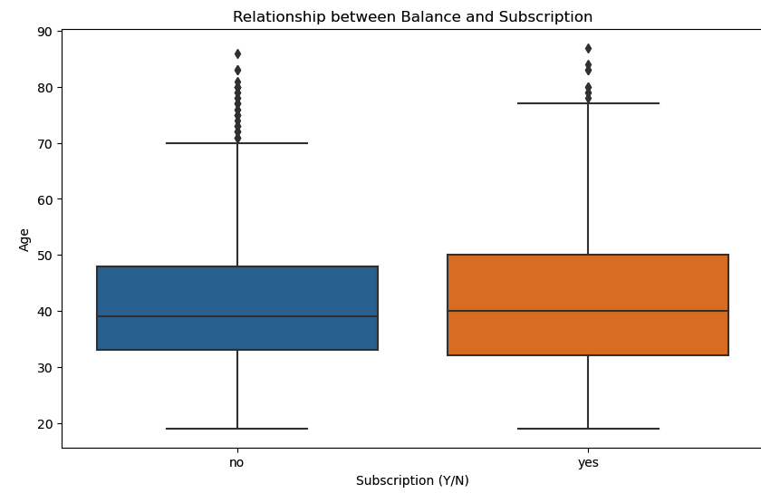
EDA Summary
Observation: As it sees, people with higher balance would subscribe more, and has slightly higher median age of early 40s. And the chart on the right-hand side says mid 30s to late 30s has the most in both balances and numbers. So mid 30s to early 40s would fit the most for our customers.

Slide 11
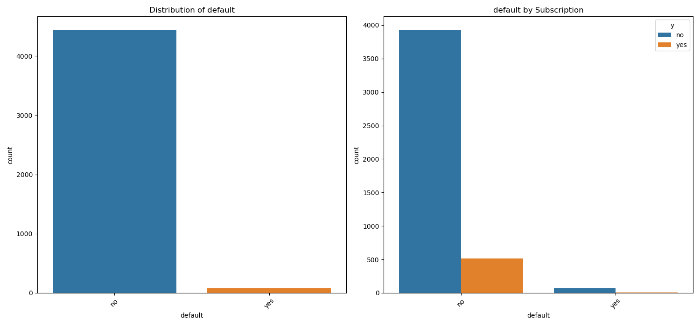
EDA Summary
Observation: Number of people who has credit in default is too low to take account and find the relationship with subscription(Y/N)

Slide 12
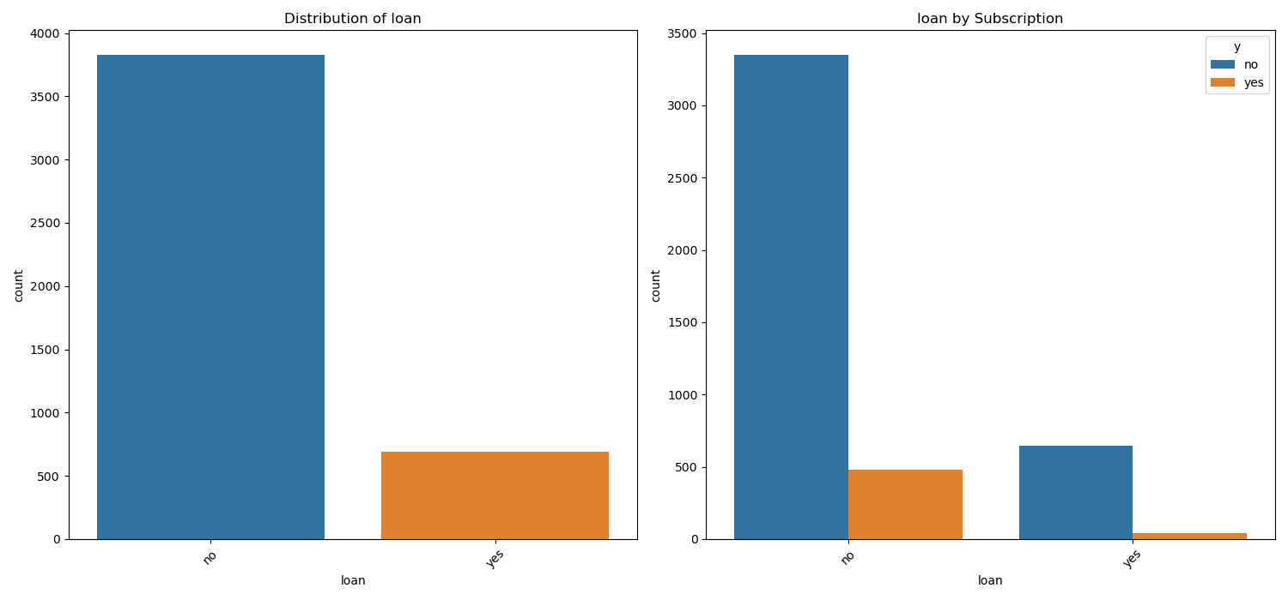
EDA Summary
Observation: Likewise, proportion Y to N of loan and subscription is almost equal. In short, Default and loan are not suitable factor for the ML model

Slide 13
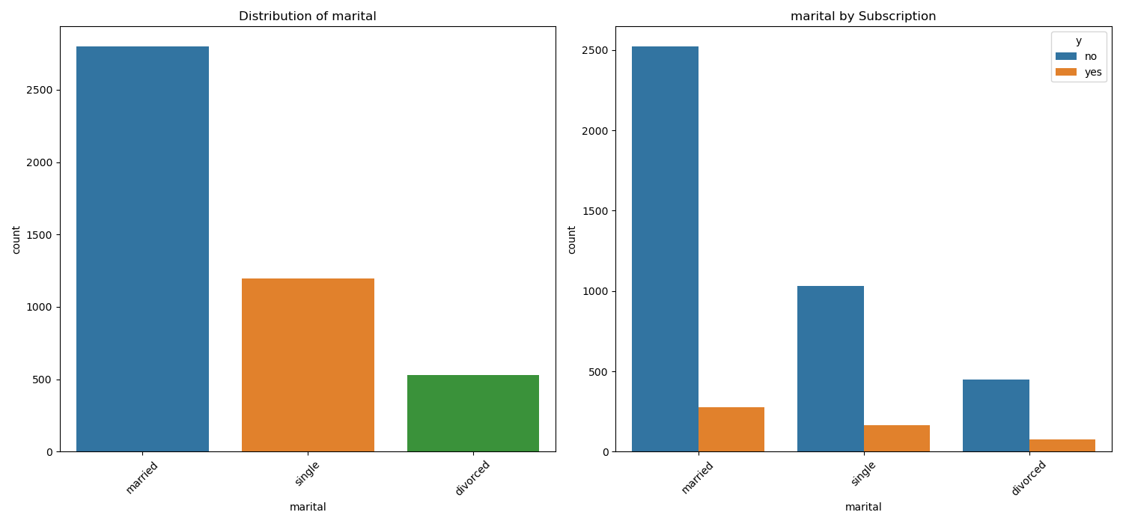
EDA Summary
Observation: I see very little correlation between marital status and subscription. So marital status is not impactful to subscription, but I can see there’s a VERRY LITTLE chance of selling out product to single than married.

Slide 14
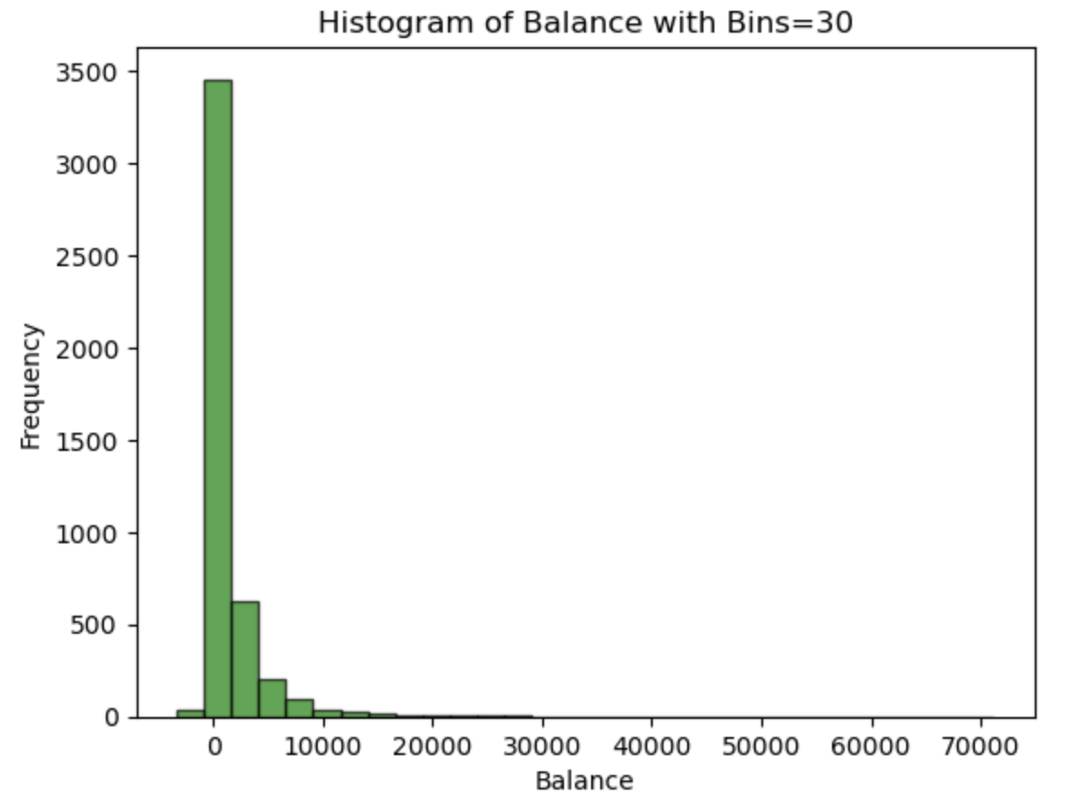
EDA Summary
Additionally, since the most of population has a balance of less than 1500, the minimum for the bank term deposit should be lower than that

Slide 15
Recommendations
Suggest focusing marketing strategies on specific age groups and job categories with higher subscription rates.

Slide 16
Conclusion
Advocate for optimizing campaign efforts based on contact duration and frequency insights.

Slide 17
Thank You

